Slide 1


HR DATA ANALYSIS
ASHEESH KUMAR
INTERNSHIP PROJECT REPORT

Slide 2
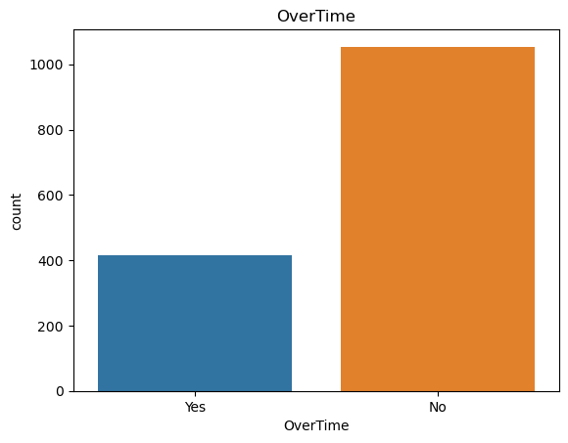
EMPLOYEE DEDICATION

Slide 3
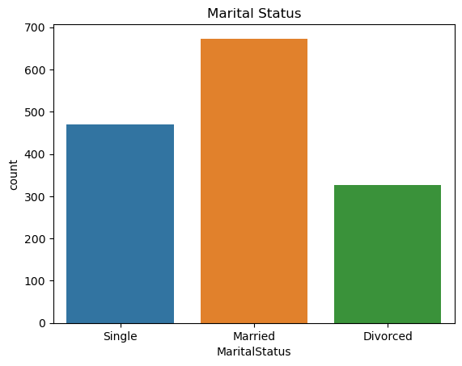
EMPLOYEE MARTIAL STATUS

Slide 4
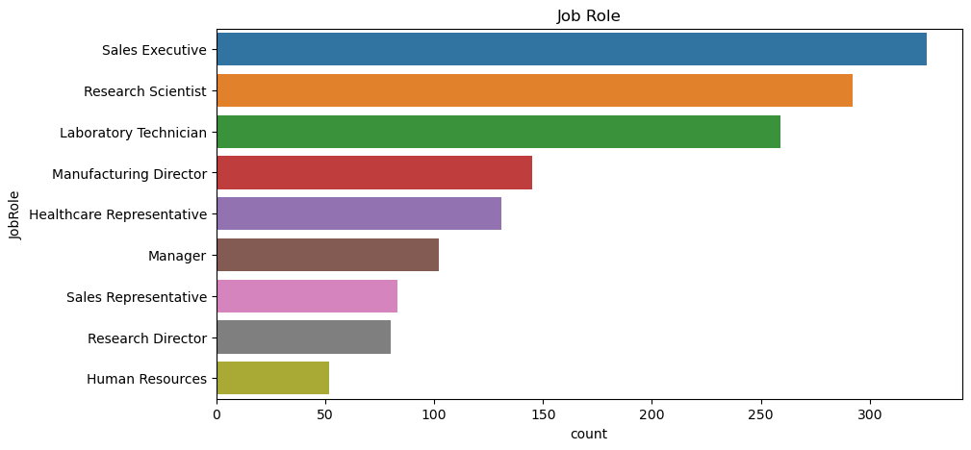
JOB ROLE

Slide 5
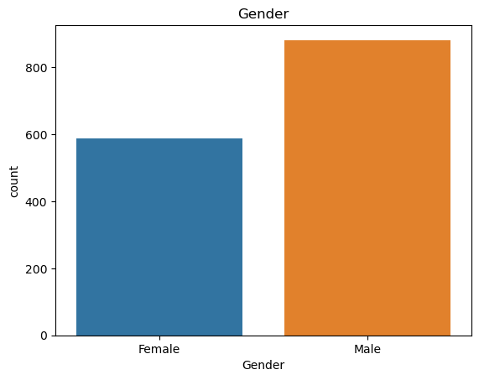
GENDER

Slide 6
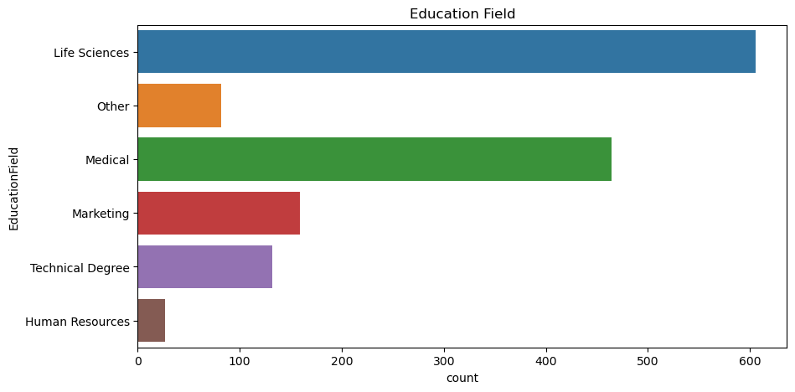
EDUCATION FEILD

Slide 7
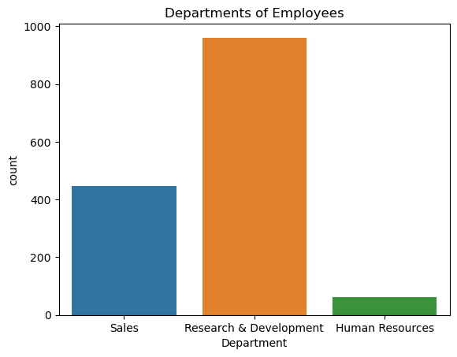
DEPARTMENT OF EMPLOYEES

Slide 8
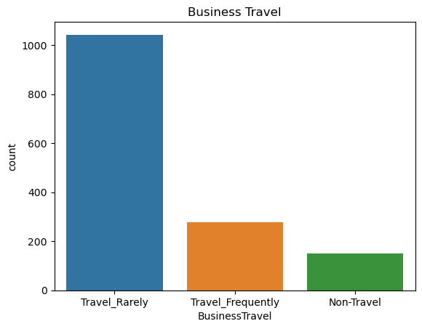
BUSINESS TRAVEL

Slide 9
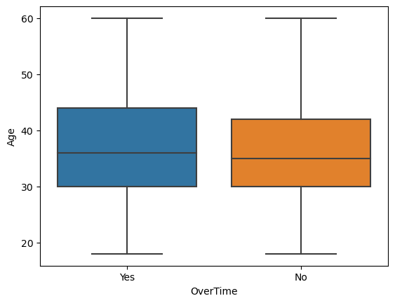
OVER TIME

Slide 10
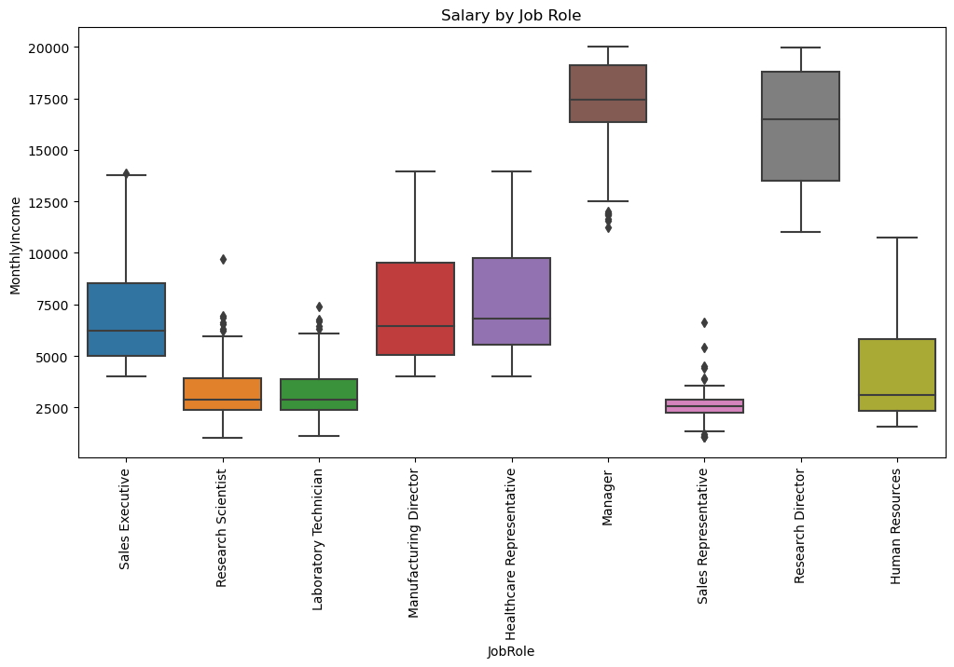
SALARY BY JOB ROLE

Slide 11
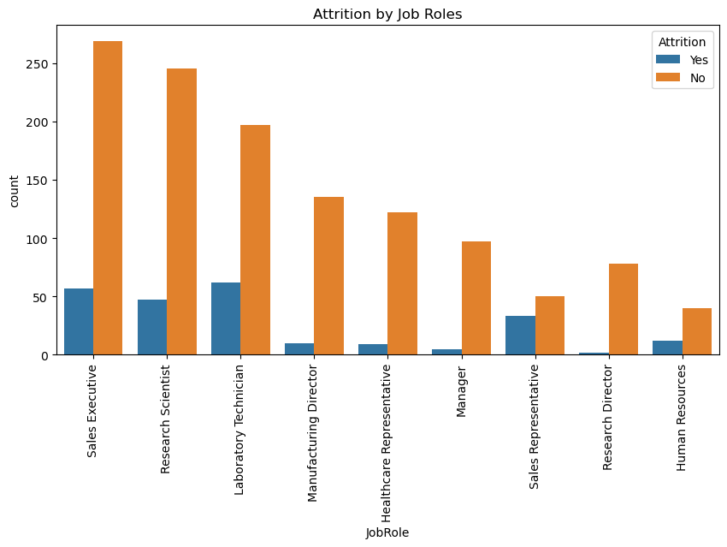
ATTRITION BY JOBS ROLES

